Slide 1

Smart Shopping Cart
ABIN SANTHOSH [Reg. No. IES22CS006]
ADHITH SUNIL [Reg. No. IES22CS007]
ADHWAITH T T [Reg. No. IES22CS008]
ANITTA RAPHI E [Reg. No. IES22CS025]
Department of CSE,
IES COLLEGE OF ENGINEERING, THRISSUR
Under the Guidance of
Ms. MEETHU M B
Assistant Professor
Department of CSE
IES COLLEGE OF ENGINEERING, THRISSUR

Slide 2
TARGETS OF THE MINI PROJECT WORK
ACTIVITIES |  | ACTIVITIES
Domain & problem identified | Yes | Development of product | Yes
Literature Review | Yes | Testing | Yes
Objectives formulated | Yes | Obtained Result | Yes
Methodology / Design | Yes | Documentation | Yes
Created work plan and task allocation | Yes | Report submission | Yes
Date:02-04-2025 IESCE Slide. No:1

Slide 3
INTRODUCTION
Smart Shopping Cart aims to enhance the shopping experience by reducing time spent at billing counters.
Traditional billing relies on barcode scanning, requiring manual effort and increasing checkout time.
The proposed system uses RFID tags instead of barcodes to streamline the shopping process.
Date:02-04-2025 IESCE Slide. No: 2

Slide 4
INTRODUCTION
Uses an RFID reader with an LCD display mounted on the shopping cart to display the price of each scanned item.
Improves overall customer satisfaction and operational efficiency in shopping malls.
Date:02-04-2025 IESCE Slide. No: 3

Slide 5
OBJECTIVES
Develop an RFID-based smart shopping cart to automate item detection and displaying item details and total cost in real time.
Date:02-04-2025 IESCE Slide. No: 4

Slide 6
EXISTING SYSTEM
The existing system relies on barcode scanning, requiring each item to be scanned manually at the checkout counter.
Manual scanning in traditional billing systems increases the chances of human errors, such as scanning the wrong item, multiple scans, or missed items, resulting in inaccurate billing.
Date:02-04-2025 IESCE Slide. No: 5

Slide 7
EXISTING SYSTEM
The dependency on barcode scanners means that damaged or missing barcodes can cause delays and require manual price entry.
Customers need to remove items from their carts for scanning, which adds inconvenience and increases the overall shopping time.
Date:02-04-2025 IESCE Slide. No: 6

Slide 8
LITERATURE REVIEW
SL NO | Name of the Paper | Outcome | Author and Publication Details
1 | Data transmission using RFID system on smart shopping carts for checkout process efficiency in supermarket at indonesia | The project resulted in the successful implementation of a Smart Shopping System, which reduced queue times by allowing customers to self-scan items, thus making the checkout process more efficient and convenient. Customers need to familiarize themselves with the self-scanning feature and smartphone app, including scanning items, checking prices, and managing shopping lists. Some may face a learning curve while adapting to this technology. | Martinusa , Metta Saridewi Wahaba , Yudia, Hanry Ham, published in the journal Procedia Computer Science, volume 179 on January 1, 2021
Date:02-04-2025 IESCE Slide. No: 7

Slide 9
SL NO | Name of the Paper | Outcome | Author and Publication Details
2 | Smart shopping cart using RFID technology | In this system, the customer begins by logging in via a QR code on the shopping cart, enabling a seamless shopping experience. The cart automatically detects items using RFID technology, updates the bill in real-time, and manages stock efficiently. A challenge in this system is ensuring user-friendly QR code login process, as some customers may face difficulties with scanning, app compatibility, or network issues, potentially delaying their shopping experience. | Susanna M Santhosh, Cemone P Babu, Jills Joseph , Preethu Benny, published in the International Journal of Engineering Applied Sciences and Technology (IJEAST), Volume 5, on June 2020.
Date:02-04-2025 IESCE Slide. No:8

Slide 10
SL NO | Name of the Paper | Outcome | Author and Publication Details
3 | IOT based Smart Shopping Cart using RFID | This system utilizes RFID technology, an Arduino microcontroller, and a Bluetooth module to track items in real time and automate billing. It reduces checkout times, provides product details, and updates inventory by recording purchases and generating bills automatically. The main challenges faced in this project include high initial setup costs, customer adaptation to new technology, ensuring data privacy and security, and the need for regular maintenance and updates. | Seshagopal , Harish D , Ashwinth Fatin , Dr. Antonidoss , published in the International Journal of Engineering Research & Technology (IJERT), Volume 10, Issue 04, in April 2021.
Date:02-04-2025 IESCE Slide. No: 9

Slide 11
SL NO | Name of the Paper | Outcome | Author and Publication Details
4 | RFID Based Smart Shopping Cart for Smart Shopping Enhanced with IoT | This RFID-based system automates billing by scanning tagged products and displaying details on an LCD screen. It reduces wait times and uses GSM modules for real-time updates and notifications. A challenge in this system is maintaining stable GSM connectivity, as network issues or poor signal strength may disrupt real-time, affecting the efficiency of the checkout process | K Sreenivasa Rao,Ayesha Shaik, N Dineshsairamreddy, H Anusha, A Guru Rajesh, published in the Journal of Emerging Technologies and Innovative Research (JETIR), Volume 10, Issue 3, in March 2023.
Date:02-04-2025 IESCE Slide. No: 10

Slide 12
SL NO | Name of the Paper | Outcome | Author and Publication Details
5 | Research on Smart Shopping Cart | This project develops an IoT-based Smart Shopping Cart using RFID technology to automate billing and enhance the shopping experience. It features automatic item detection, reduces checkout wait times. The system integrates an microcontroller, GSM module, LCD, and keypad to display costs. challenge for this system is ensuring seamless communication between the GSM module and the server, as network disruptions or delays could affect real-time transaction updates and payment notifications, leading to a less efficient shopping experience. | Prof. Roopa C , Nivas Chandra Reddy, published in the Journal of Emerging Technologies and Innovative Research (JETIR), Volume 11, Issue 3, in March 2024.
Date:02-04-2025 IESCE Slide. No: 11

Slide 13
PROPOSED SYSTEM
RFID Scanning: Scan items as you add them to the cart for instant recording.
Real-Time Display: LCD screen displays item details and updated totals.
Automated Billing: Cart maintains a live total for fast and easy checkout.
No Manual Scanning: Eliminates manual barcode scanning, reducing cashier workload and wait times.
Date:02-04-2025 IESCE Slide. No: 12

Slide 14
ADVANTAGES
Reduced Checkout Stress
Efficient Multi-Item Scanning
Increased Customer Satisfaction
Date:02-04-2025 IESCE Slide. No: 13

Slide 15
METHODOLOGY
Module 1: RFID-Based Product Identification Module
Objective: Automatically detect and identify products added to the cart
Components: RFID Tags → RFID Reader → Microcontroller
Module 2. Billing & Pricing Module
Objective: Maintain an updated total bill as products are added/removed.
Components: Microcontroller → Display Unit
Date:02-04-2025 IESCE Slide. No: 14

Slide 16
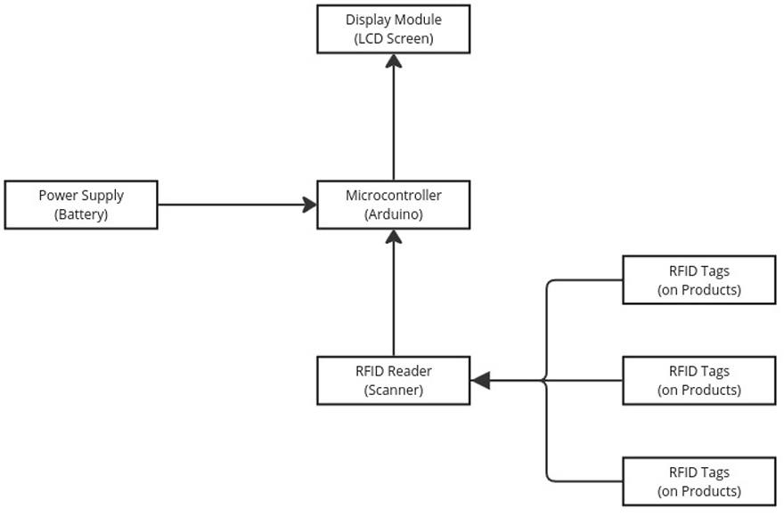
BLOCK DIAGRAM
Date:02-04-2025 IESCE Slide. No: 15

Slide 17
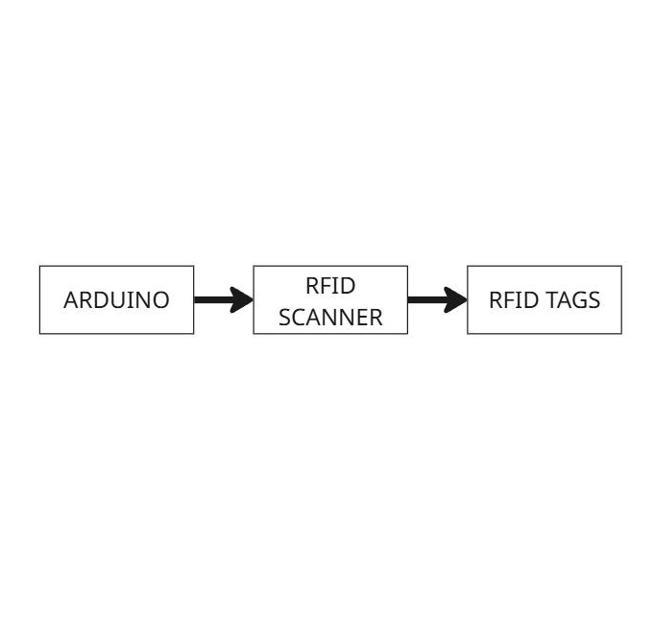
LEVEL 0 BLOCK DIAGRAM
Date:02-04-2025 IESCE Slide. No: 16

Slide 18
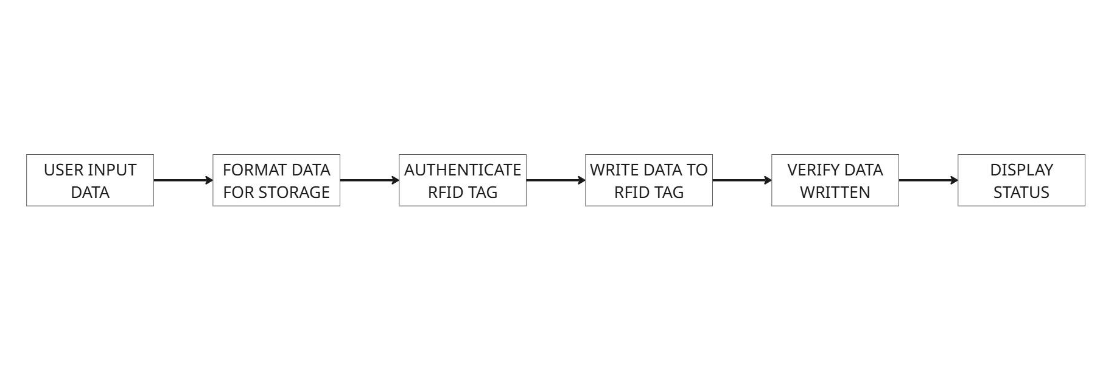
LEVEL 1 BLOCK DIAGRAM
Date:02-04-2025 IESCE Slide. No: 17

Slide 19
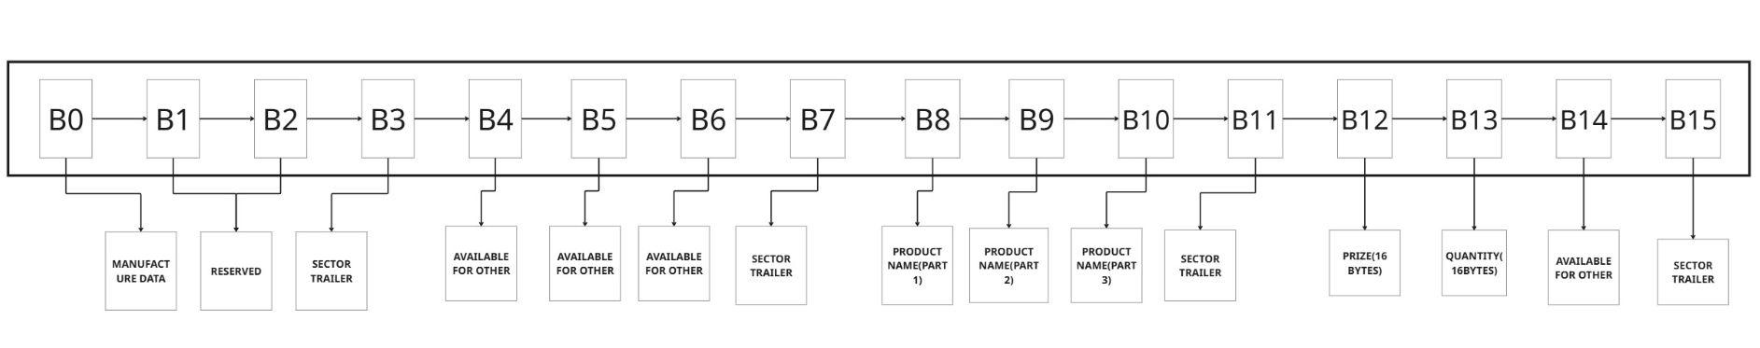
LEVEL 2 BLOCK DIAGRAM
Date:02-04-2025 IESCE Slide. No: 18

Slide 20
RESOURCES NEEDED
SOFTWARE REQUIREMENTS:
Arduino IDE
HARDWARE REQUIREMENTS:
RFID Reader (Mounted on the cart)
RFID Tags (Attached to products)
Microcontroller (Arduino)
Display Unit (LCD)
Power Supply(Rechargeable battery)
Date:02-04-2025 IESCE Slide. No: 19

Slide 21
WORK PLAN
ABIN SANTHOSH
Development & Implementation
ADHITH SUNIL
Project Monitoring & Quality Check
ADHWAITH T T
Testing & Risk Management
Documentation & Resource Handling
ANITTA RAPHI E
Date:02-04-2025 IESCE Slide. No: 20

Slide 22
FEASIBILITY ANALYSIS
Technical Feasibility
Economic Feasibility
Social Feasibility
Legal & Ethical Feasibility
Date:02-04-2025 IESCE Slide. No: 21

Slide 23
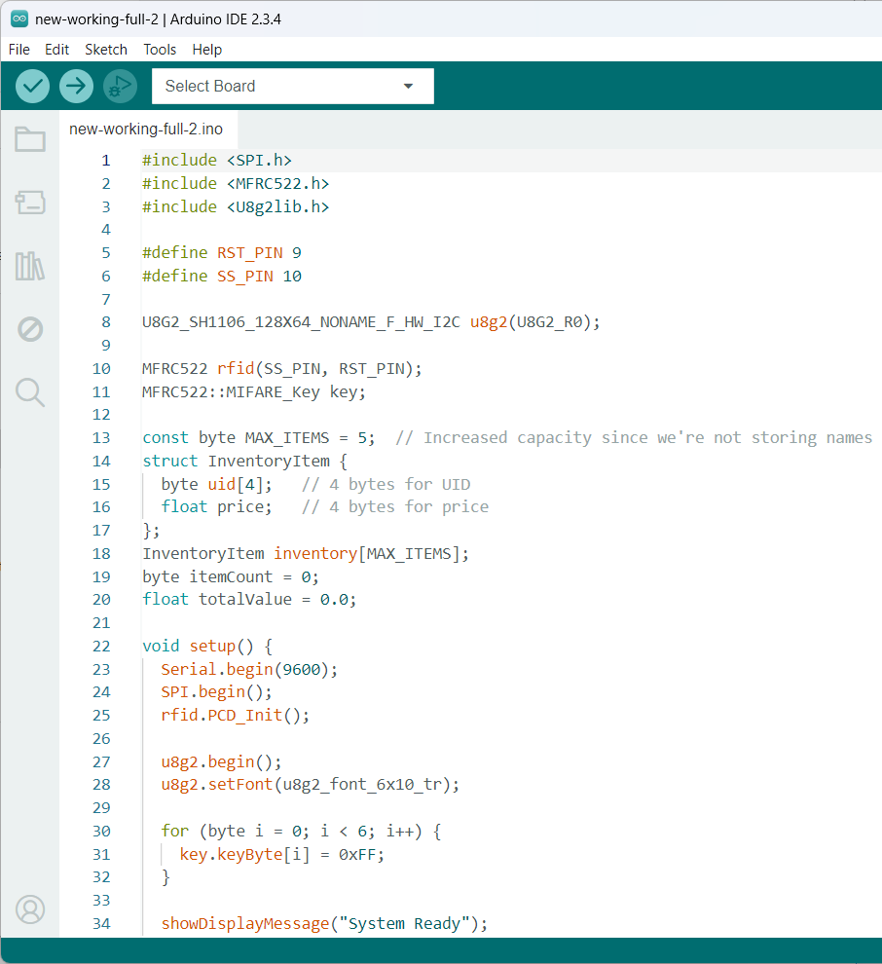
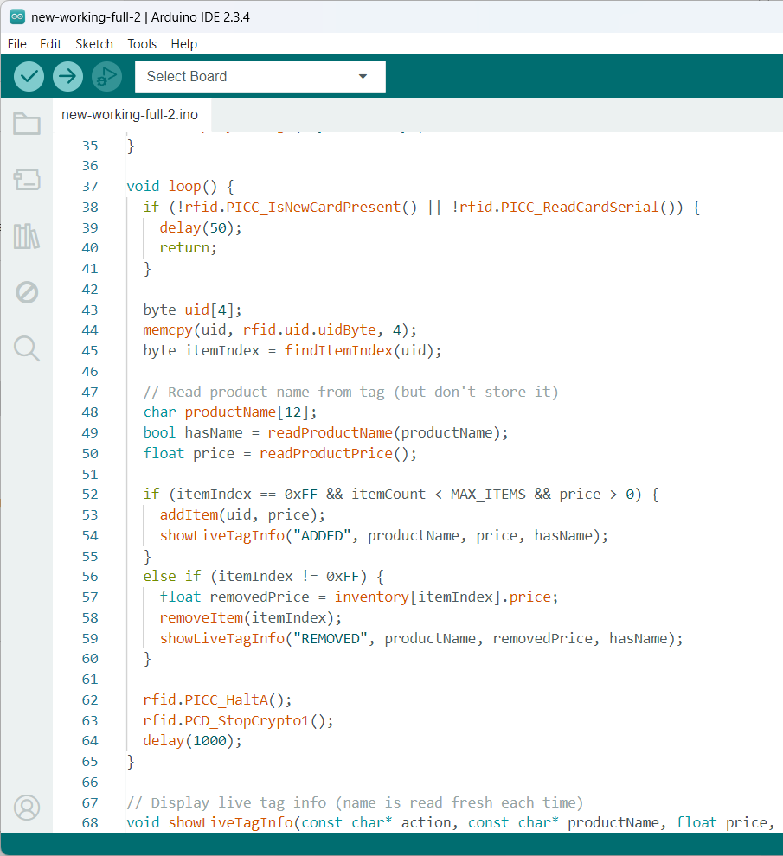
CODING SNAPS
Date:02-04-2025 IESCE Slide. No: 22

Slide 24
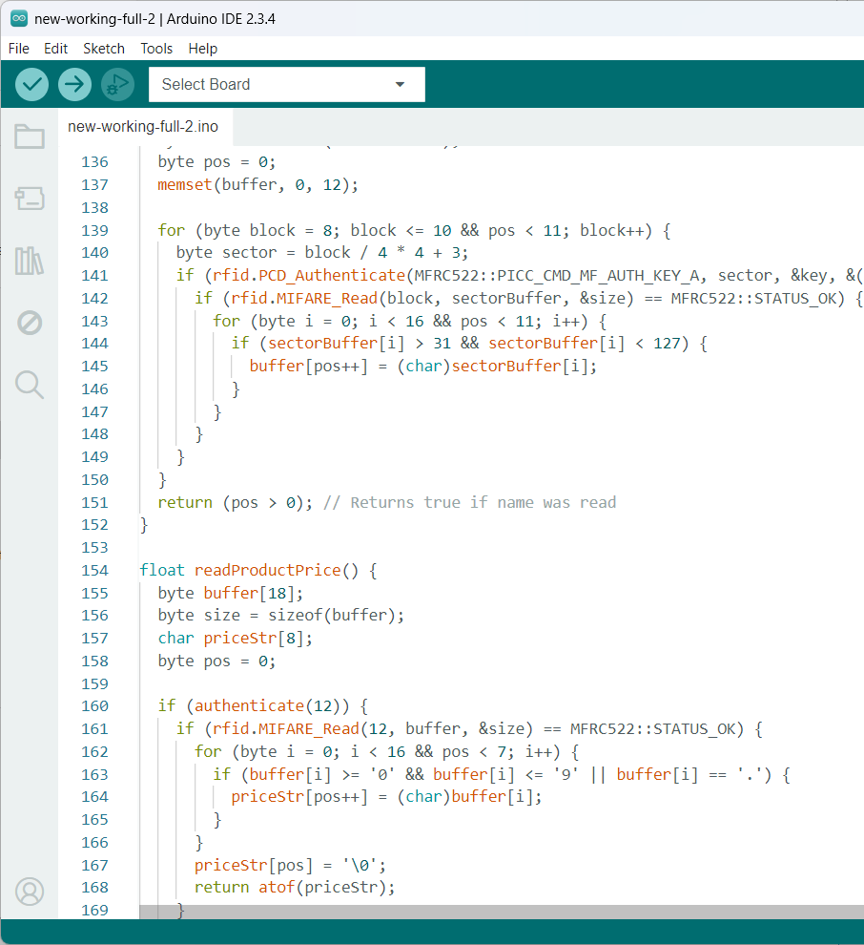
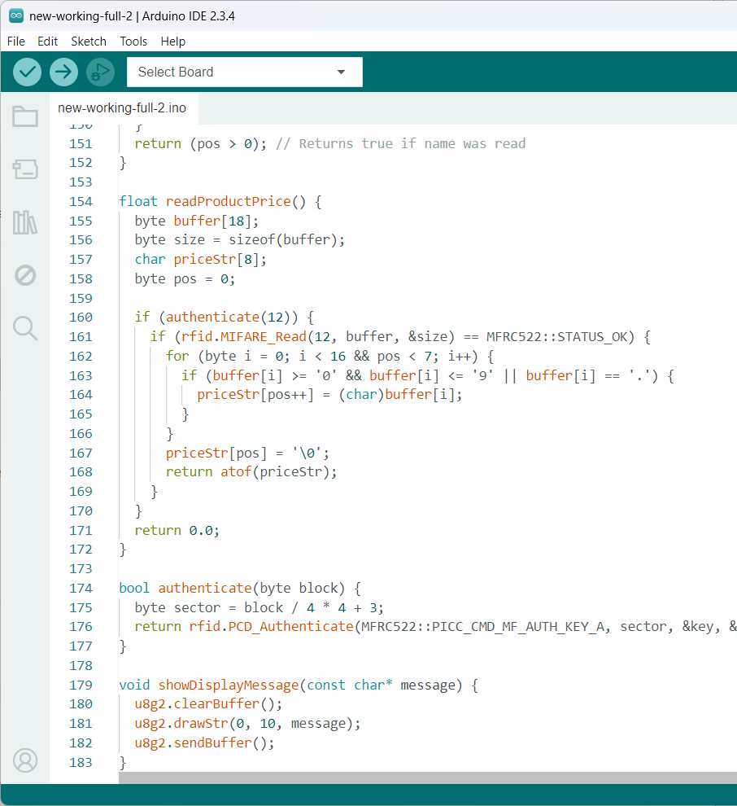
CODING SNAPS
Date:02-04-2025 IESCE Slide. No: 23

Slide 25
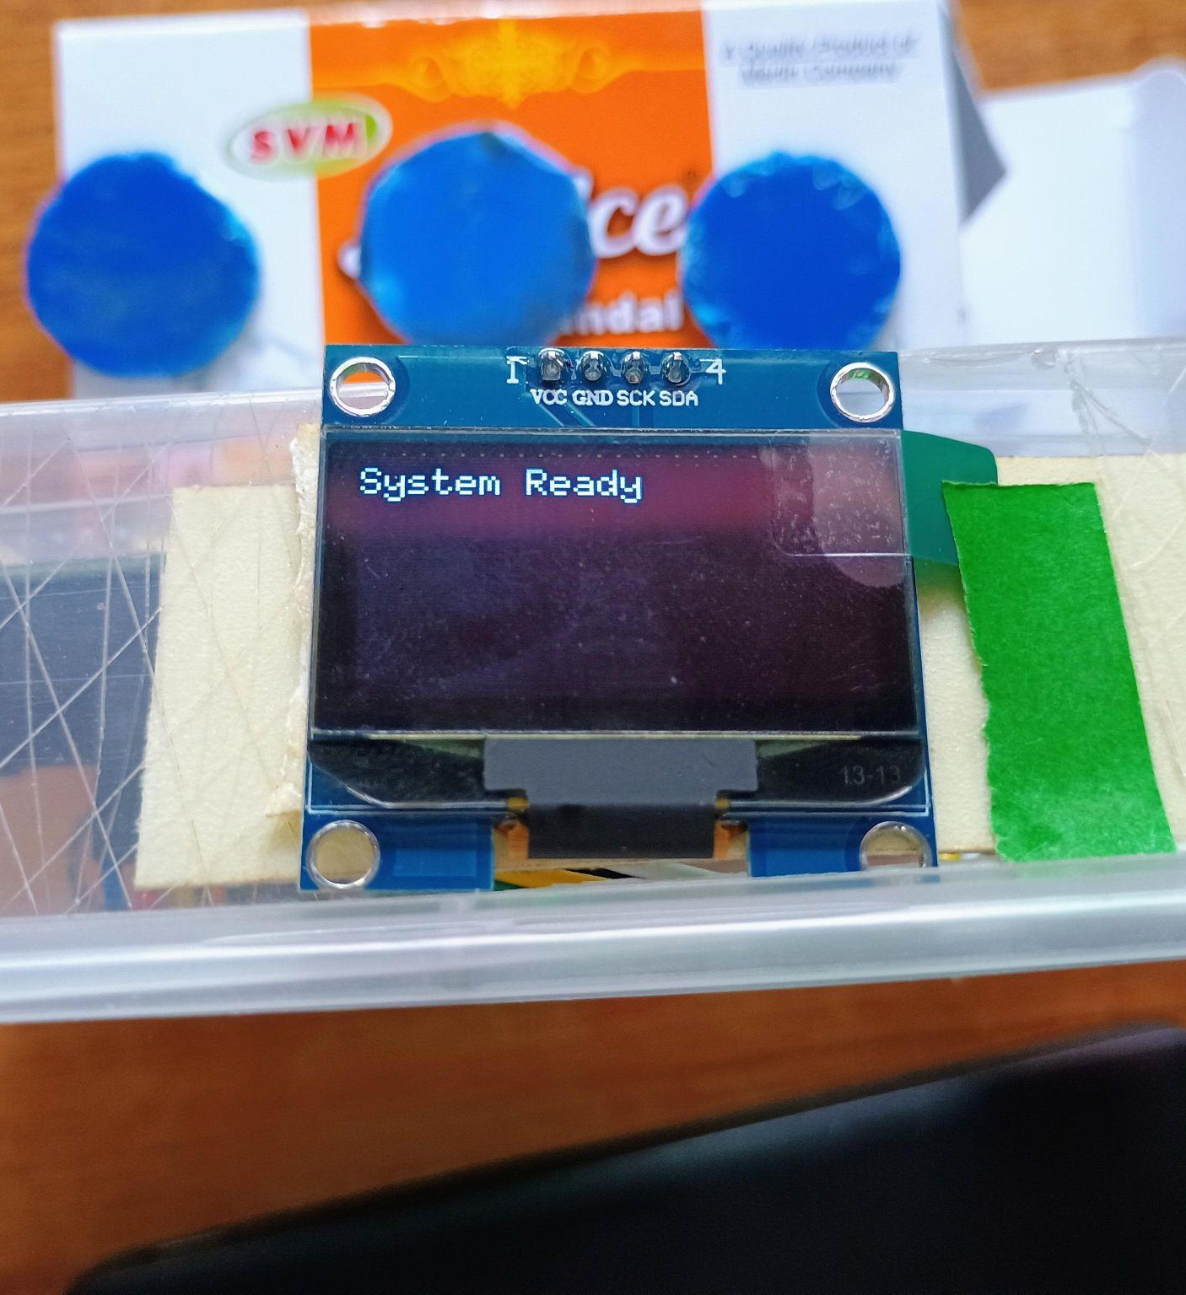
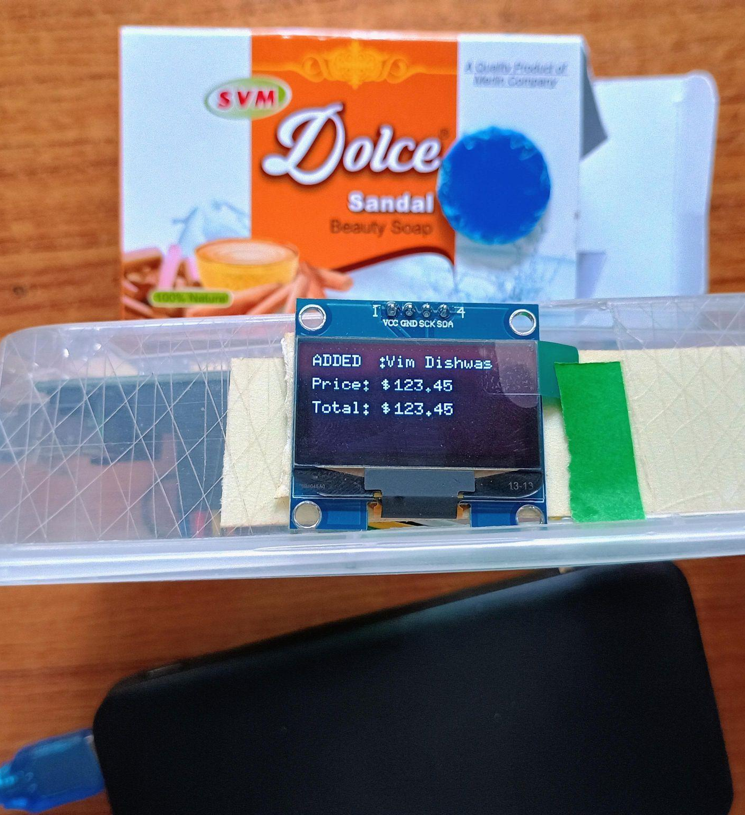
OUTPUT
Date:02-04-2025 IESCE Slide. No: 24

Slide 26
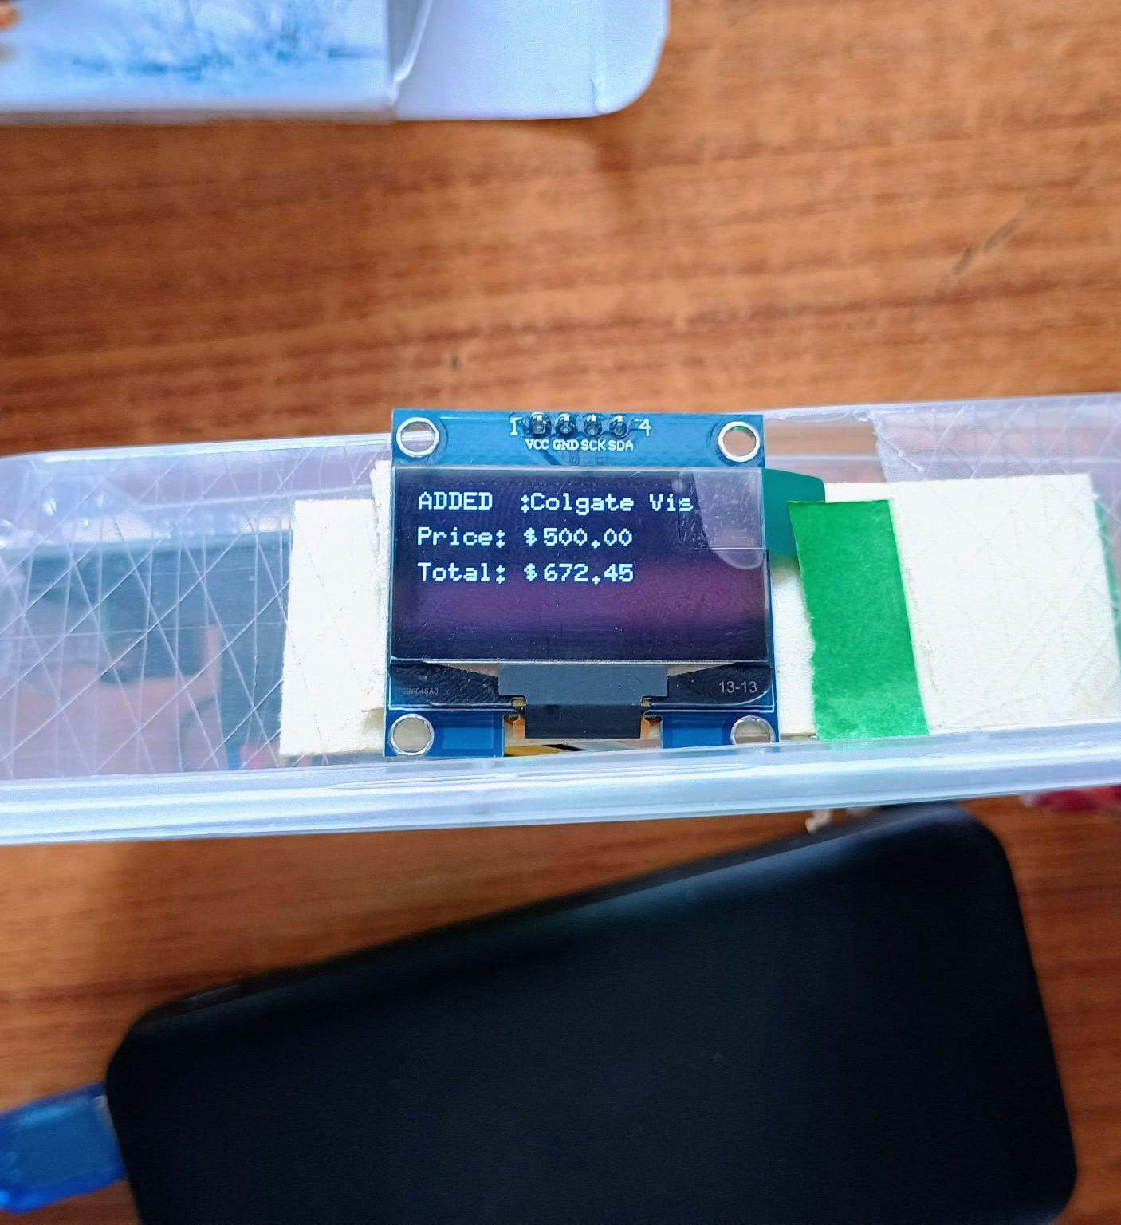
OUTPUT
Date:02-04-2025 IESCE Slide. No: 25

Slide 27
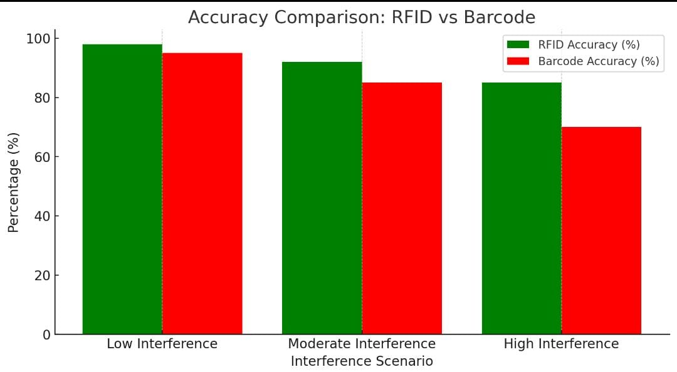
PERFORMANCE ANALYSIS
Date:02-04-2025 IESCE Slide. No: 26

Slide 28
TESTING METHODS
Unit Testing (Individual Components): Test RFID detection, data writing/reading, display messages, and price calculations.
Integration Testing (Component Interaction): Verify RFID and Arduino communication, OLED display updates, and duplicate scan handling.
Functional Testing (End-to-End System Check): Ensure correct product addition/removal, cart total updates, and error handling.
Date:02-04-2025 IESCE Slide. No: 27

Slide 29
TESTING METHODS
Stress Testing (Performance Under Load): Test multiple tag scans, power failure recovery, and system response time.
User Experience Testing (Ease of Use): Check read distance, angles, and overall user-friendliness.
Security Testing (Prevent Unauthorized Access): Test with unauthorized tags and detect data tampering attempts.
Date:02-04-2025 IESCE Slide. No: 28

Slide 30
CONCLUSION
We planned our work before implementation.
The problem statement was defined, and the methodology was finalized.
All necessary components were procured.
The Smart Shopping Cart using RFID technology was successfully implemented.
It improves shopping convenience and retail efficiency.
Despite some challenges, it offers benefits like faster checkout and better inventory management.
Date:02-04-2025 IESCE Slide. No: 29

Slide 31
REFERENCES
[1] Susanna M Santhosh, Cemone P Babu, Jills Joseph , Preethu Benny,
published in the International Journal of Engineering Applied Sciences and Technology (IJEAST), Volume 5, on June 2020.
[2] Martinusa , Metta Saridewi Wahaba , Yudia, Hanry Ham, published in the journal Procedia Computer Science, volume 179 on January 1, 2021.
[3] Seshagopal , Harish D , Ashwinth Fatin , Dr. Antonidoss ,
published in the International Journal of Engineering Research & Technology (IJERT), Volume 10, Issue 04, in April 2021.
Date:02-04-2025 IESCE Slide. No: 30

Slide 32
REFERENCES
[4] K Sreenivasa Rao,Ayesha Shaik, N Dineshsairamreddy, H Anusha, A Guru Rajesh,published in the Journal of Emerging Technologies and Innovative Research (JETIR), Volume 10, Issue 3, in March 2023.
[5] Prof. Roopa C , Nivas Chandra Reddy,published in the Journal of Emerging Technologies and Innovative Research (JETIR), Volume 11, Issue 3, in March 2024.
Date:02-04-2025 IESCE Slide. No: 31

Slide 33
THANK YOU

